Slide 1
Policy Review of Women, Girls and Gender Equality and NSPs
Dr Jackie Mangoma

Slide 2
Gender inequalities: Reflections & Issues (Gender Based Violence)

Slide 3
What were the aims and methods of the Desk Review
The Desk Review:
Aimed to provide a ‘snapshot’ of current strengths, weaknesses and gaps and make recommendations.
Focused on the latest available National Strategic Plan in 2010
Addressed 20 countries: Angola, Botswana, Comoros, Eritrea, Ethiopia, Kenya, Lesotho, Madagascar, Malawi, Mauritius, Mozambique, Namibia, Rwanda, Seychelles, South Africa, Swaziland, Tanzania, Uganda, Zambia and Zimbabwe

Slide 4
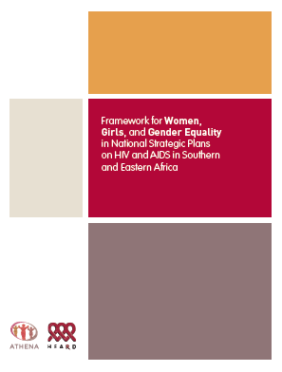
Framework for Women, Girls and Gender Equality in NSPs on HIV and AIDS in Southern and Eastern Africa

Slide 5
Findings and analysis
NSPs frequently include ‘headlines’ for women, girls and gender equality, but fail to follow through
Focus in NSPs limited to increasing access to and uptake of treatment for women and girls and PMTCT
Most NSPs focus on providing ‘technical’ solutions

Slide 6
Findings and analysis (2)
Major gaps include:
Failure to recognize and meaningfully programme for gender-based violence
Failure to address strengthening care and support programmes
Other gaps include:
Lack of meaningful involvement of women living with HIV and their sexual and reproductive health rights
Lack of attention to gender expertise
Lack of costed and budgeted interventions
Lack of sex disaggregated data or sex specific targets.

Slide 7
Findings and analysis
12 out of 20 National Strategic Plans scored zero on ‘eliminating gender-based violence and discrimination’
Only 3 of the regions’ National Strategic Plans specifically ‘affirm the sexual and reproductive health and rights of women living with HIV’

Slide 8
Overview of women, girls and gender equality in NSPs in the region

Slide 9
Recommendations to countries - Summary
Fostering an enabling environment that advances human rights and access to justice
Strengthening the meaningful involvement of and leadership by women living with and affected by HIV
Utilizing a sexual and reproductive health and rights approach
Eliminating gender-based violence and discrimination
Strengthening care and support by and for women and girls

Slide 10
Recommendations to countries – key priorities
Fostering an enabling environment that advances human rights and access to justice
Key priority: Institutionalising supportive and legal policy frameworks
Strengthening the meaningful involvement of and leadership by women living with and affected by HIV
Key priority: Clear processes and mechanisms outlined
Utilising a sexual and reproductive health and rights approach
Key priority: Linkage of sexual and reproductive health and HIV services
Eliminating gender-based violence and discrimination
Key priority: Interventions to create supportive legal and policy frameworks
Strengthening care and support by and for women and girls
Key priority: Strengthening of health systems to reduce women’s unpaid care burden

Slide 11
Eliminating Gender-Based Violence and Discrimination (Key Areas)
Attention must also be paid to addressing GBV in all its forms: IPV, sexual violence, psychological violence as well as systematic, structural violence in peace, conflict and post conflict settings
Specific interventions:
Creation of supportive legal and policy environment to prevent and redress all forms of violence against women
Legal reform to criminalise marital rape
Comprehensive post rape care protocols for HIV prevention ( See Framework)

Slide 12
Concluding message
National Strategic Plans on HIV are critical instruments for addressing the particular priorities, needs and vulnerabilities of women and girls, and for advancing gender equality - both of which are central to the success of the HIV response

