Slide 1


Jean Kemitare
Raising Voices
www.raisingvoices.org

Slide 2
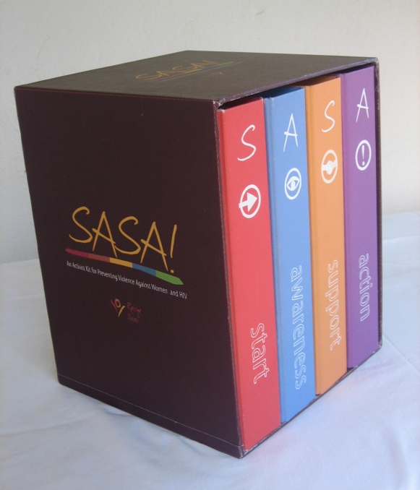
What is SASA!?
A community mobilization approach to preventing violence against women and HIV. Documented in the SASA! Activist Kit. Organized into four phases to influence community norms:
  Start (knowledge)
  Awareness (knowledge & attitudes)
  Support (skills)
  Action (behaviour)

Slide 3
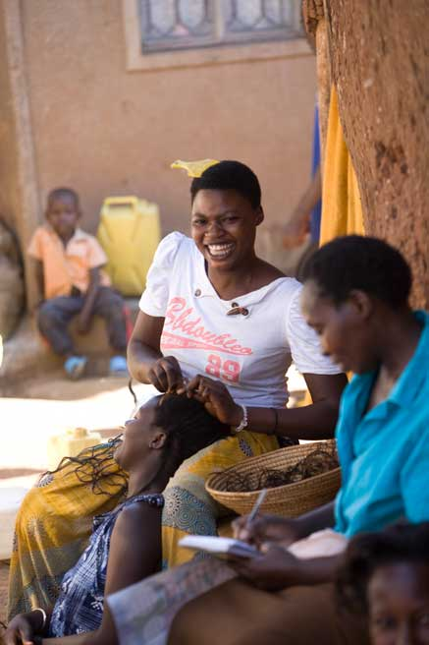
Why was SASA! created?
Need for approaches that move beyond traditional VAW and HIV programming to focus on root issues – fusing public health and social justice
Need for programming that can challenge and transform social norms that uphold gender inequality – long term and systematic
Transform the policy statements/calls for work on the linkage into practical, actionable programming

Slide 4
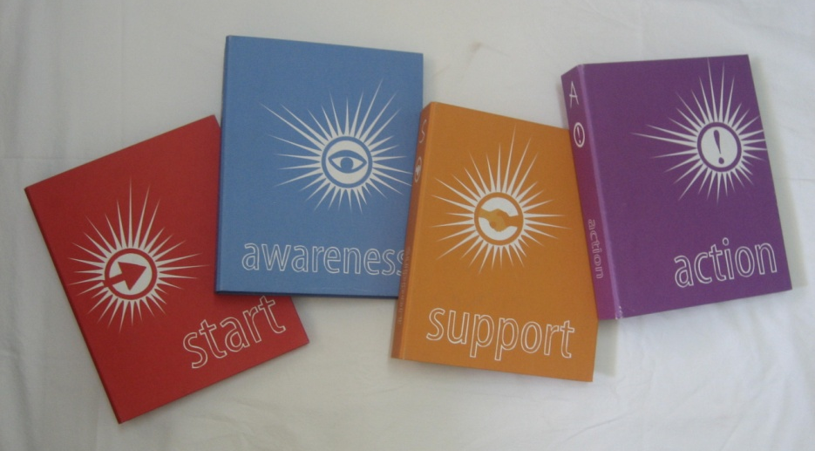
Process of SASA!
Scaling up individual ‘Stages of Change’ to the phases of community mobilization level
  Start (pre-contemplation)
  Awareness (contemplation)
  Support (preparing for action)
  Action (action and maintenance)

Slide 5
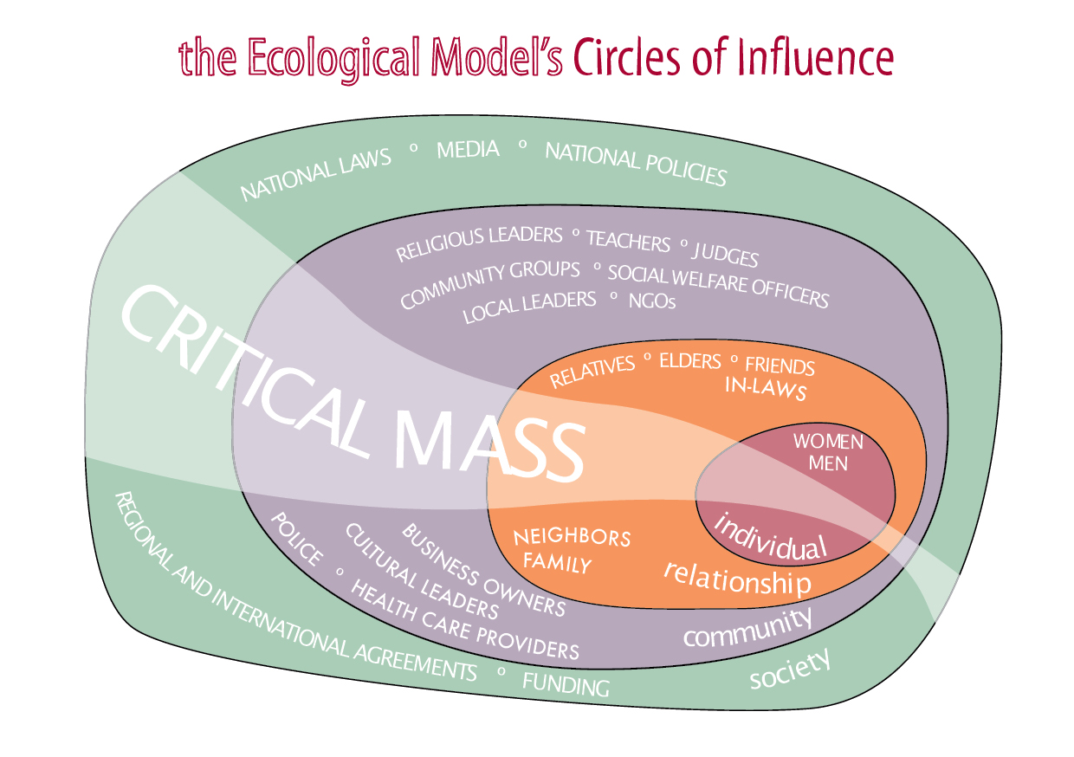
Structure of SASA!

Slide 6

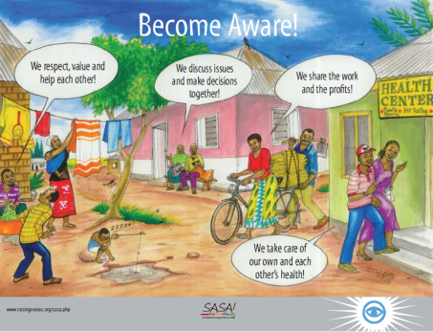
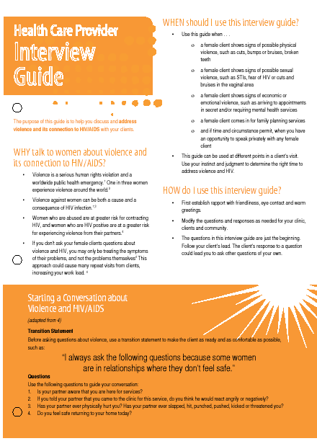
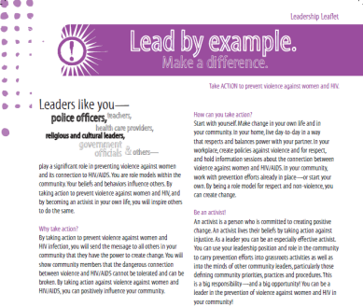
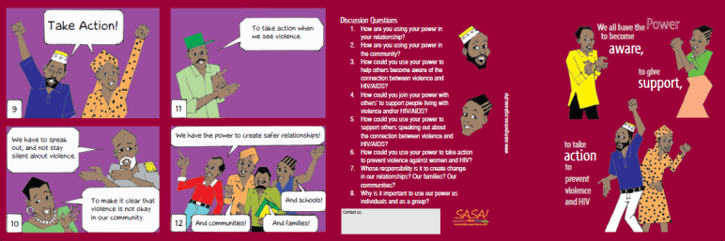
SASA! Strategies
Activities to reach out to all levels in the community to affect social norm change
Local Activism
Media and Advocacy
Communication Materials
Training
Content evolves with each phase

Slide 7
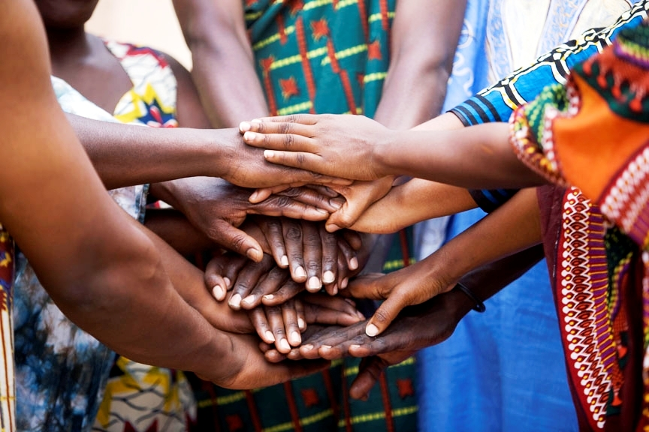
Content of SASA!
  Transforming gender relations through positive, benefits-based programming
  Power within (start)
  Power over (awareness)
  Power with (support)
  Power to (action)

Slide 8
Program Monitoring
RCT with min partner CEDOVIP, LSTMH, MUK 2007-2012
Simple tools for NGOs to assess progress ad impact. Indicators developed for each phase, these tracked in simple tools that feed back into quality program design
    Baseline
    Activity Report Form
    Outcome Tracking Tool
    Rapid Assessment Survey
    Follow up

Slide 9
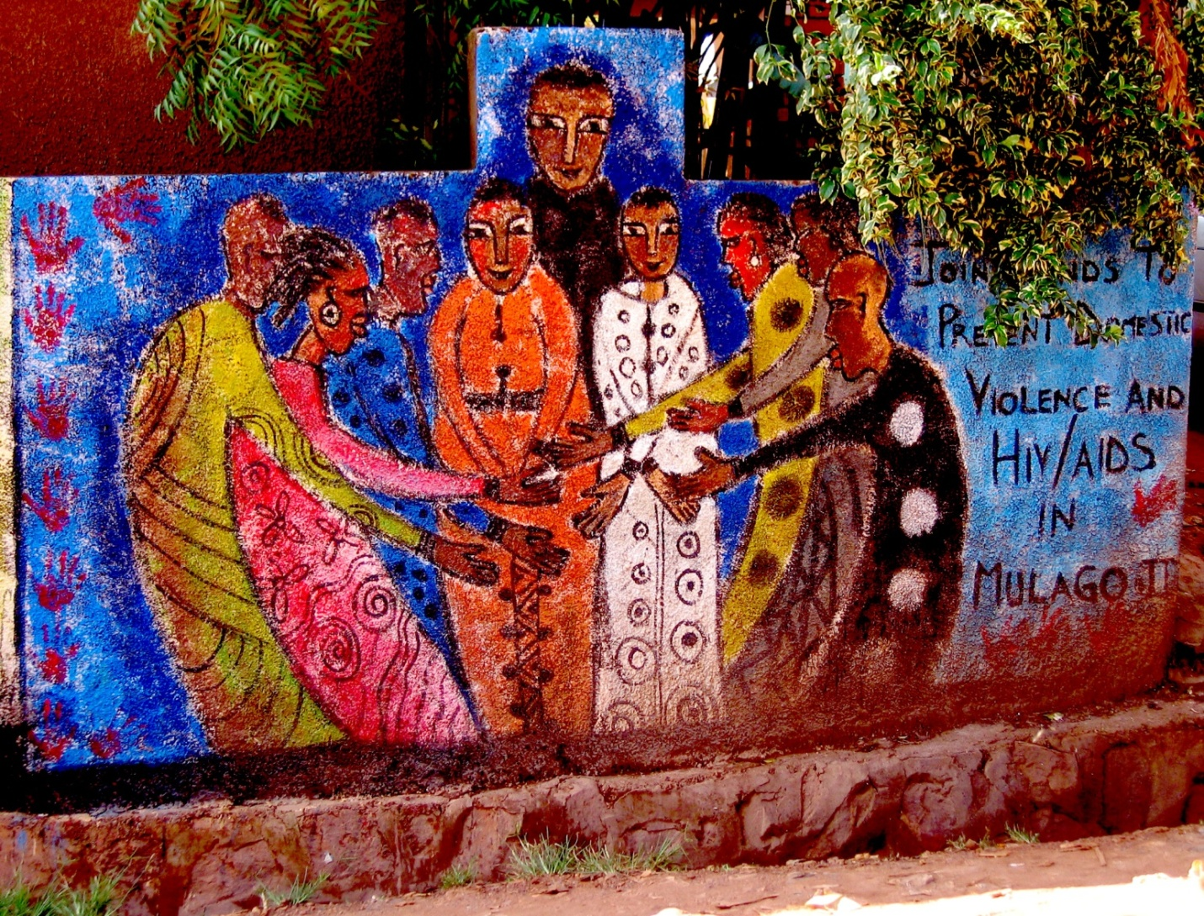
Thank you!

