Slide 1
Framework for Women, Girls & Gender Equality in NSPs Recommendation 3:
Champion leadership for an enabling environment that promotes and protects the human rights of women and girls and their empowerment in the context of HIV through increased advocacy and capacity and adequate resources

Slide 2
Championing Leadership: Realizing rights
Result 3.1: Women and girls are empowered to drive transformation of social norms and unequal power relations, in the context of HIV
Result 3.2: Strong, bold and diverse leadership for women, girls, gender equality, for their participation in decision-making in the context of HIV
Result 3.3: Increased financial resources for women, girls and gender equality in the context of HIV.
Result 3.4: Gender-responsive UNAIDS.

Slide 3
Meaningful Involvement of Women Living with HIV (MIWA)
We ensure that:
The realities of HIV positive women and girls are reflected in prevention, care, treatment and support activities
Services fit and work for women and girls, rather than women and girls being made to fit into services
Programmes include a focus on women and girls who are already living with HIV

Slide 4
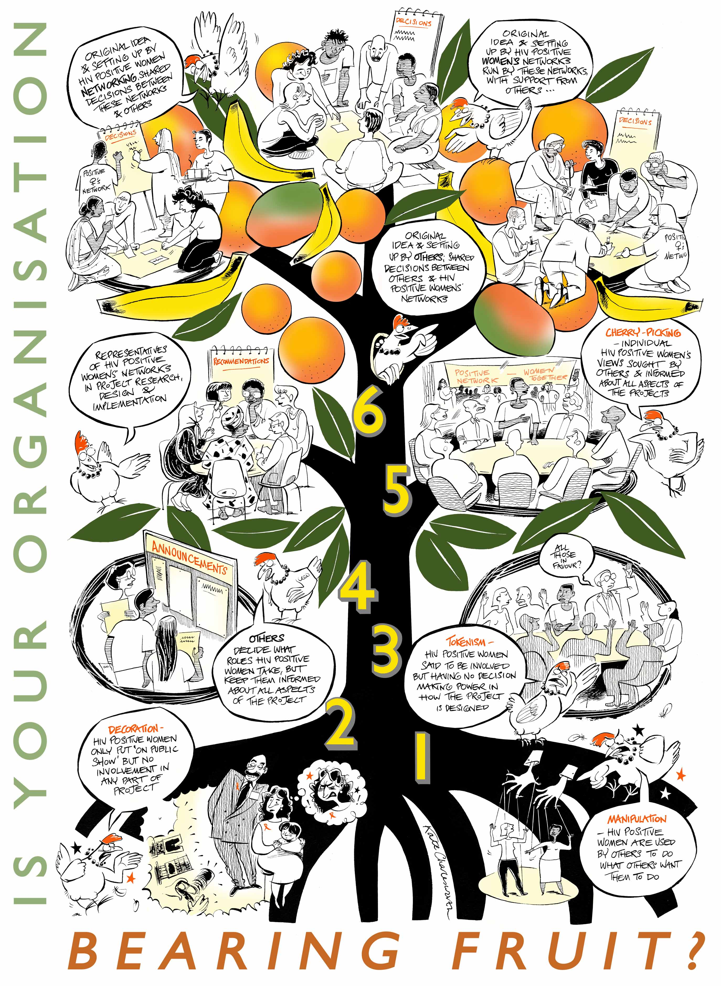
ICW Tree of participation
Original idea and setting up by HIV positive women’s networks; run by these networks with support from others
Original idea and setting up by HIV positive women networking; shared decisions between these networks and others
Original idea and setting up by others; shared decisions between others and HIV positive women’s networks

Slide 5
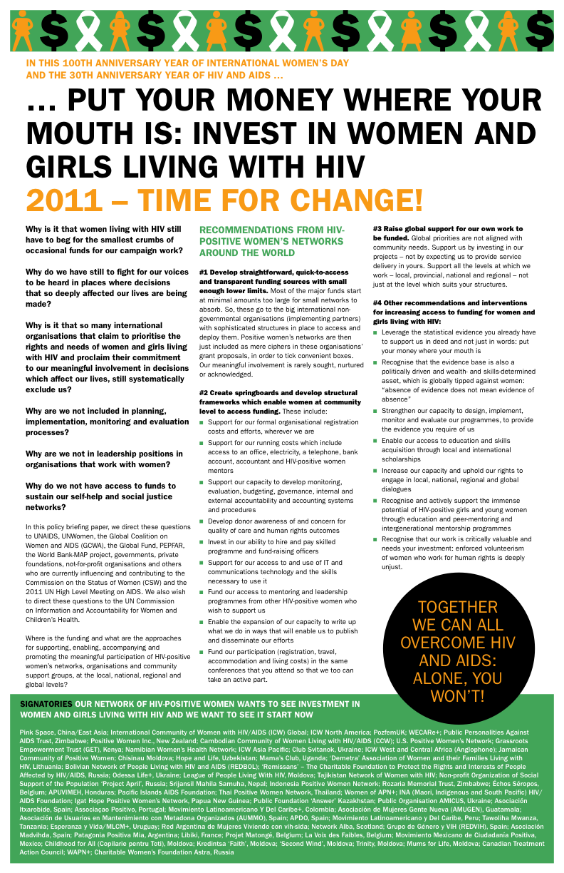

Slide 6
Policy Briefing: put your money where your mouth is
#1 Develop straightforward, quick-to-access and transparent funding sources with small enough lower limits.
#2 Create springboards and develop structural frameworks which enable women at community level to access funding.
#3 Raise global support for our own work to be funded
#4 Other recommendations and interventions for increasing access to funding for women and girls living with HIV:

